Slide 1
INFORMATION ONLY
NCCU Investment
Portfolio at a Glance
February 29, 2024
Prepared for Board of Trustees:
Administration and Finance

Slide 2
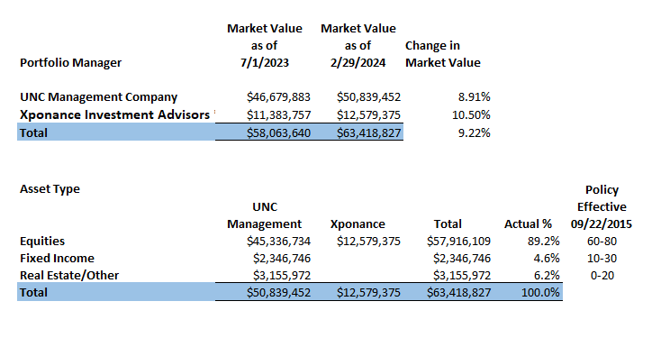

Slide 3
Periodic Performance vs Benchmark

Slide 4
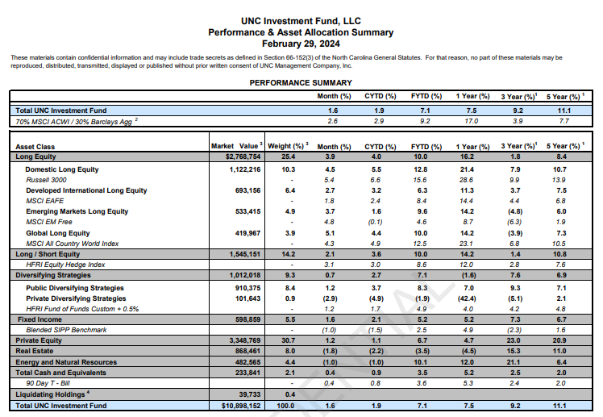

Slide 5
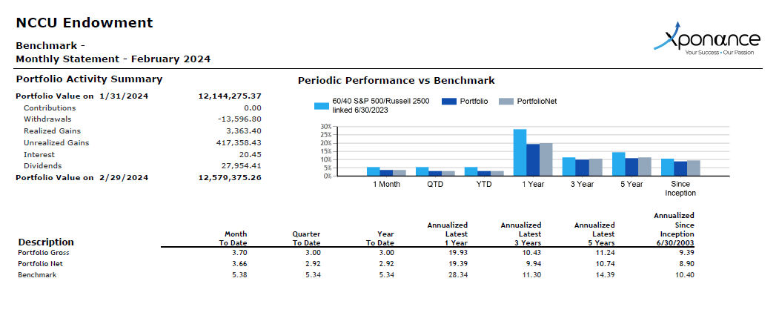

Slide 6
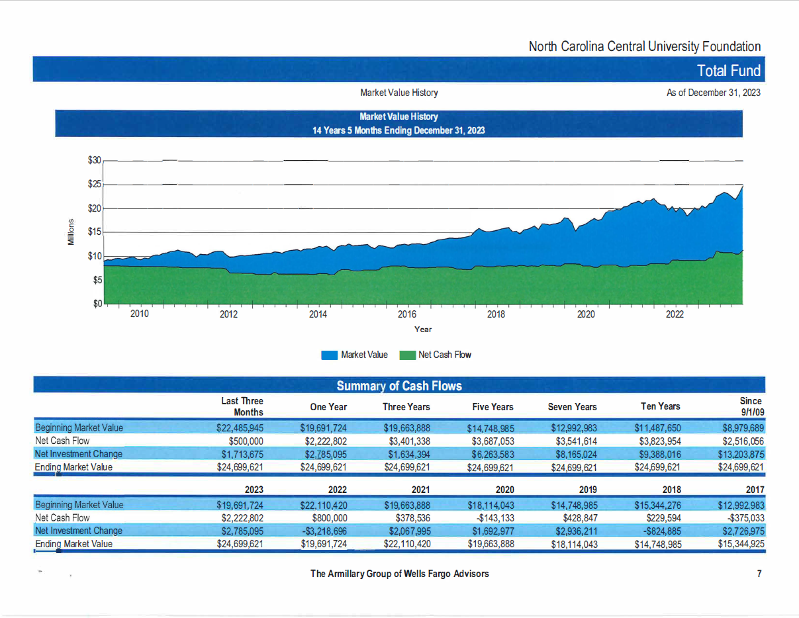

Slide 7
NOTES:

Slide 8
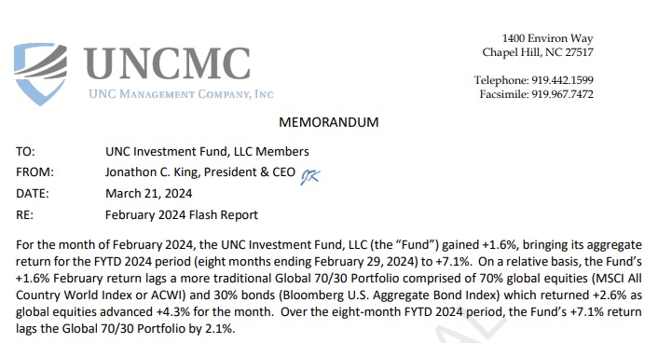
UNCMC Memorandum 1 of 3

Slide 9
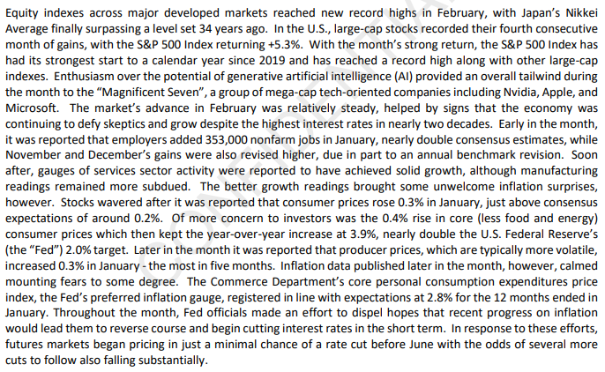
UNCMC Memorandum 2 of 3

Slide 10
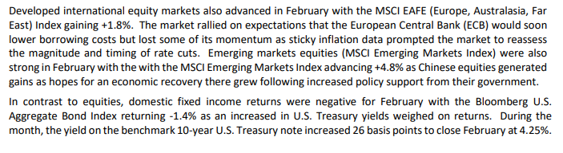
UNCMC Memorandum 3 of 3

Slide 11
1. The performance (i.e., investment returns) of UNC Investment Fund and Xponance Investment Advisors Fund will
not necessarily match the percentage change in the market values of NCCU's portfolios. As a result of cash flows
during the year (i.e. additions and withdrawals to the funds), the investment returns will NOT equal the percent
change calculated by looking at the beginning market values versus the ending market value during the year, as
some dollars are only invested for a portion of the year and wouldn't have earned the full return for the year.
2. The Strategic Investment Policy Portfolio ("SIPP") and Standard and Poor's (S&P) 500 Benchmarks are the
primary benchmarks against which UNC Management and Piedmont Investment Advisors, respectively, measure
their investment performance. |  | The UNC Management benchmark is only calculated on a quarterly basis.
3. NCCU's Performance Returns reflect the FYTD market returns for the various portfolios, less any permanent
additions or withdrawals.
4. The Management Fees for the Fiscal agents are: Piedmont Investment Advisors - 45 basis points, UNC
Management Company - 50 basis points

